Slide 1
Haggai 2.1-9

Slide 2
People: former exiles living in Jerusalem
Zerubbabel: rightful king, serving as Persian overseer
Joshua: rightful high priest
Haggai: God’s chosen prophet

Slide 3
Haggai 2.1-3 ESV: In the seventh month, on the twenty-first day of the month, the word of the LORD came by the hand of Haggai the prophet: “Speak now to Zerubbabel the son of Shealtiel, governor of Judah, and to Joshua the son of Jehozadak, the high priest, and to all the remnant of the people, and say, ‘Who is left among you who saw this house in its former glory? How do you see it now? Is it not as nothing in your eyes?’”
Feast of Tabernacles
remembered deliverance in exodus
celebrated deliverance in harvest
when Solomon dedicated his temple

Slide 4
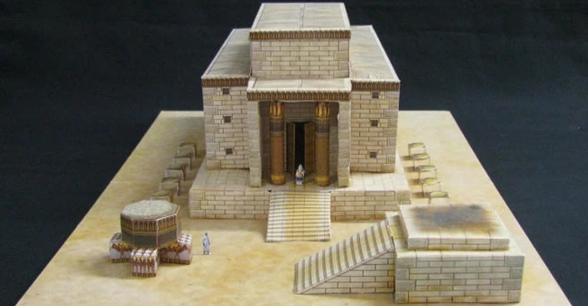
‘Who is left among you who saw this house in its former glory?
How do you see it now? Is it not as nothing in your eyes?’
Model of Solomon’s Temple
Image from windowintotheBible.com

Slide 5
‘Who is left among you who saw this house in its former glory?
How do you see it now? Is it not as nothing in your eyes?’
Ritmeyer & Ritmeyer, Jerusalem in the Time of Nehemiah, 25; ©2005 Carta Jerusalem

Slide 6
Haggai 2.4-5 ESV: “‘Yet now be strong, O Zerubbabel, declares the LORD. Be strong, O Joshua, son of Jehozadak, the high priest. Be strong, all you people of the land, declares the LORD. Work, for I am with you, declares the LORD of hosts, according to the covenant that I made with you when you came out of Egypt. My Spirit remains in your midst. Fear not.’”
A1. Command: Be strong and get to work!
B1. Reassurance: I am with you! I am the Lord Almighty!
C. Theology: I made a covenant promise in the Exodus.
B2. Reassurance: The Holy Spirit is still with you!
A2. Command: Do not fear!

Slide 7
Haggai 2.4-5 ESV: “‘Yet now be strong, O Zerubbabel, declares the LORD. Be strong, O Joshua, son of Jehozadak, the high priest. Be strong, all you people of the land, declares the LORD. Work, for I am with you, declares the LORD of hosts, according to the covenant that I made with you when you came out of Egypt. My Spirit remains in your midst. Fear not.’”
A1. Command: Be strong and get to work!
B1. Reassurance: I am with you! I am the Lord Almighty!
C. Theology: I made a covenant promise in the Exodus.
B2. Reassurance: The Holy Spirit is still with you!
A2. Command: Do not fear!

Slide 8
Haggai 2.4-5 ESV: “‘Yet now be strong, O Zerubbabel, declares the LORD. Be strong, O Joshua, son of Jehozadak, the high priest. Be strong, all you people of the land, declares the LORD. Work, for I am with you, declares the LORD of hosts, according to the covenant that I made with you when you came out of Egypt. My Spirit remains in your midst. Fear not.’”
A1. Command: Be strong and get to work!
B1. Reassurance: I am with you! I am the Lord Almighty!
C. Theology: I made a covenant promise in the Exodus.
B2. Reassurance: The Holy Spirit is still with you!
A2. Command: Do not fear!

Slide 9
Haggai 2.4-5 ESV: “‘Yet now be strong, O Zerubbabel, declares the LORD. Be strong, O Joshua, son of Jehozadak, the high priest. Be strong, all you people of the land, declares the LORD. Work, for I am with you, declares the LORD of hosts, according to the covenant that I made with you when you came out of Egypt. My Spirit remains in your midst. Fear not.’”
A1. Command: Be strong and get to work!
B1. Reassurance: I am with you! I am the Lord Almighty!
C. Theology: I made a covenant promise in the Exodus.
B2. Reassurance: The Holy Spirit is still with you!
A2. Command: Do not fear!

Slide 10
Do what God says,
trust God with the results and everything else.
Model of Herod’s temple complex at the time of Jesus

Slide 11
Haggai 2.6-9 ESV: “‘For thus says the LORD of hosts: Yet once more, in a little while, I will shake the heavens and the earth and the sea and the dry land. And I will shake all nations, so that the treasures of all nations shall come in, and I will fill this house with glory, says the LORD of hosts. The silver is mine, and the gold is mine, declares the LORD of hosts. The latter glory of this house shall be greater than the former, says the LORD of hosts. And in this place I will give peace, declares the LORD of hosts.’”

Slide 12
Haggai 2.6-9 ESV: “‘For thus says the LORD of hosts: Yet once more, in a little while, I will shake the heavens and the earth and the sea and the dry land. And I will shake all nations, so that the treasures of all nations shall come in, and I will fill this house with glory, says the LORD of hosts. The silver is mine, and the gold is mine, declares the LORD of hosts. The latter glory of this house shall be greater than the former, says the LORD of hosts. And in this place I will give peace, declares the LORD of hosts.’”

Slide 13
Haggai 2.6-9 ESV: “‘For thus says the LORD of hosts: Yet once more, in a little while, I will shake the heavens and the earth and the sea and the dry land. And I will shake all nations, so that the treasures of all nations shall come in, and I will fill this house with glory, says the LORD of hosts. The silver is mine, and the gold is mine, declares the LORD of hosts. The latter glory of this house shall be greater than the former, says the LORD of hosts. And in this place I will give peace, declares the LORD of hosts.’”

Slide 14
Haggai 2.6-9 ESV: “‘For thus says the LORD of hosts: Yet once more,
in a little while, I will shake the heavens and the earth and the sea and the dry land. And I will shake all nations, so that the treasures of all nations shall come in, and I will fill this house with glory, says the LORD of hosts. The silver is mine, and the gold is mine, declares the LORD of hosts. The latter glory of this house shall be greater than the former, says the LORD of hosts. And in this place I will give peace, declares the LORD of hosts.’”

Slide 15
Haggai 2.9: “‘The future splendor of this temple will be greater than that of former times,’ the LORD who rules over all declares, ‘and in this place I will give peace.’”
שָׁלוֹם is a deeper concept than our sense of peace.

Slide 16
Hebrews 12.26-29 ESV: …now he has promised, “Yet once more I will shake not only the earth but also the heavens.”
This phrase [beginning] “Yet once more,” indicates the removal of things that are shaken-- that is, things that have been made-- in order that the things that cannot be shaken may remain.
Therefore let us be grateful for receiving a kingdom that cannot be shaken, and thus let us offer to God acceptable worship, with reverence and awe, for our God is a consuming fire.

Slide 17
Haggai’s people rebuilt the temple.
500 years later, Herod made it bigger & ornate. Jesus taught there.
In AD70 the Romans destroyed the temple.
Ezekiel said there will be a large temple in the millennial kingdom.
Afterward, there will be no need for a temple.
Revelation 21.22 ESV: I saw no temple in the city, for its temple is the Lord God the Almighty and the Lamb.

Slide 18
For a devotion on Haggai 2.1-9, go to
groben.com/otprophecy.php

